Slide 1


ABC Company Pvt Ltd
SALES REPORT

Slide 2

ABC Company Pvt Ltd
INTRODUCTION
Welcome to our Sales Report Presentation. Today, we delve into a comprehensive overview of our sales performance, exploring the highs, challenges, and strategic insights that have shaped our journey. This presentation is more than just numbers, it's a narrative of our collective efforts, showcasing the impact of our sales strategies and the pathways to future success.

Slide 3

ABC Company Pvt Ltd
AGENDA
01
Company Details
02
Objective
03
Problem Statement
04
Overview Dashboard
05
Deatail Dashbaord

Slide 4
ABC Company Pvt Ltd
COMPANY DETAILS
.Our company is a car dealership that sells various car models. To effectively track and analyse our sales performance, we need a comprehensive Car Sales Dashboard in Power BI.

Slide 5

ABC Company Pvt Ltd
OBJECTIVE
The objective of this project is to design and develop a dynamic and interactive Car Sales Dashboard using Power BI. The dashboard will visualize critical KPIs related to our car sales, helping us understand our sales performance over time and make data-driven decisions.

Slide 6
ABC Company Pvt Ltd
PROBLEM STATEMENT 01
Sales Overview
Cars Sold Metrics
Year-to-Date (YTD) Total Sales
Month-to-Date (MTD) Total Sales
Year-over-Year (YOY) Growth in Total Sales
Difference between YTD Sales and Previous Year-to-Date (PTYD) Sales
YTD Cars Sold
MTD Cars Sold
YOY Growth in Cars Sold
Difference between YTD Cars Sold and PTYD Cars Sold
Average Price Analysis
YTD Average Price
MTD Average Price
YOY Growth in Average Price
Difference between YTD Average Price and PTYD Average Price

Slide 7
ABC Company Pvt Ltd
PROBLEM STATEMENT 02
YTD Sales Weekly Trend
Other Requirement
Display a line chart illustrating the weekly trend of YTD sales. The X-axis should represent weeks, and the Y-axis should show the total sales amount.
YTD Total Sales by Color: Present the contribution of various car colors to the YTD total sales through a pie chart.
YTD Cars Sold by Dealer Region: Showcase the YTD sales data based on different dealer regions using a map chart to visualize the sales distribution geographically.
Company-Wise Sales Trend in Grid Form: Provide a tabular grid that displays the sales trend for each company. The grid should showcase the company name along with their YTD sales figures.
YTD Total Sales by Body Style
Visualize the distribution of YTD total sales across different car body styles using a Pie chart.

Slide 8
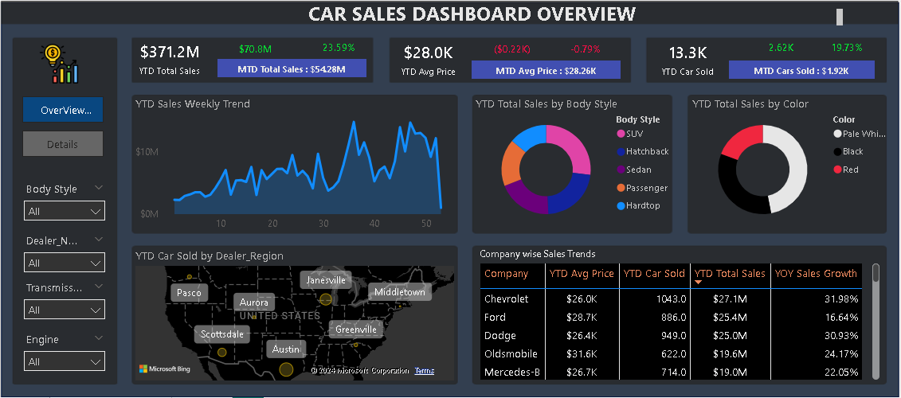
ABC Company Pvt Ltd

Slide 9
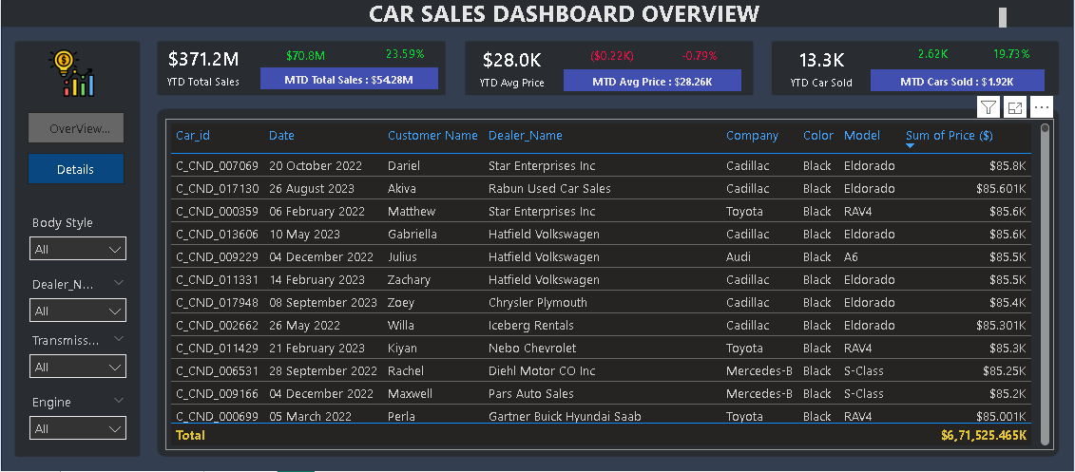
ABC Company Pvt Ltd

Slide 10
ABC Company Pvt Ltd
THANK YOU

